Slide 1
Group 1: Presentation 3 IMDCGD111-15YRD Ubisoft Adversarial Brief
James Pyke
Matthew Lummis
Benjamin Attebery

Slide 2
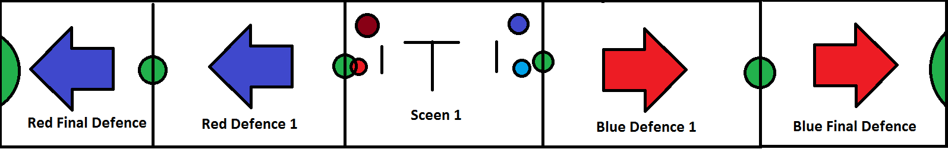
Logline
Arena style base capture game.

Slide 3
Genre
Demographic
Base Capture Game for 2-4 players
Predominantly males: 16-29
Hard fun and People Fun - Strategy and Goals as well as Social bonding and competition.

Slide 4
Objective
First team to capture the enemy’s home base wins.
Tug-of-war based strategy

Slide 5
Physics Mechanics
Recoil
Augment movement
Risk involved as it can negatively impact your positioning
Knockback
Deny opponent capturing outposts and bases through knockback from projectiles.

Slide 6
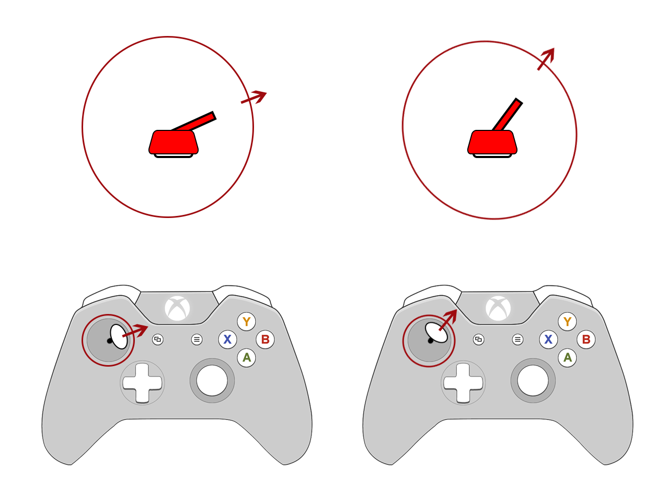
What the Player Does
Direction

Slide 7
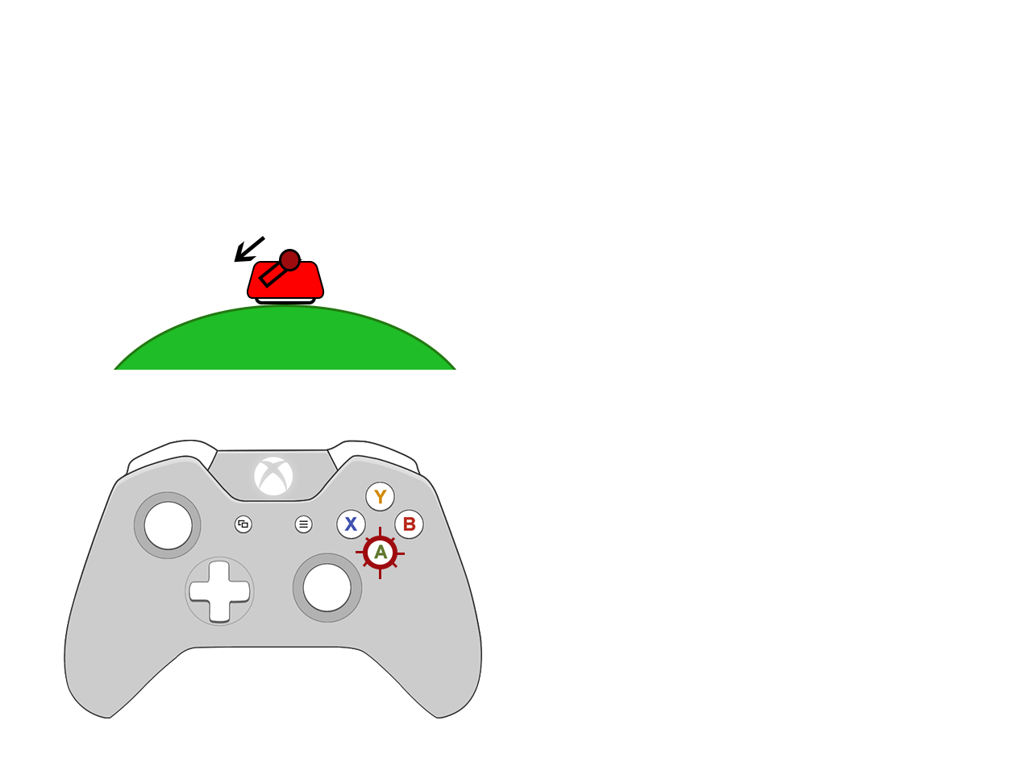
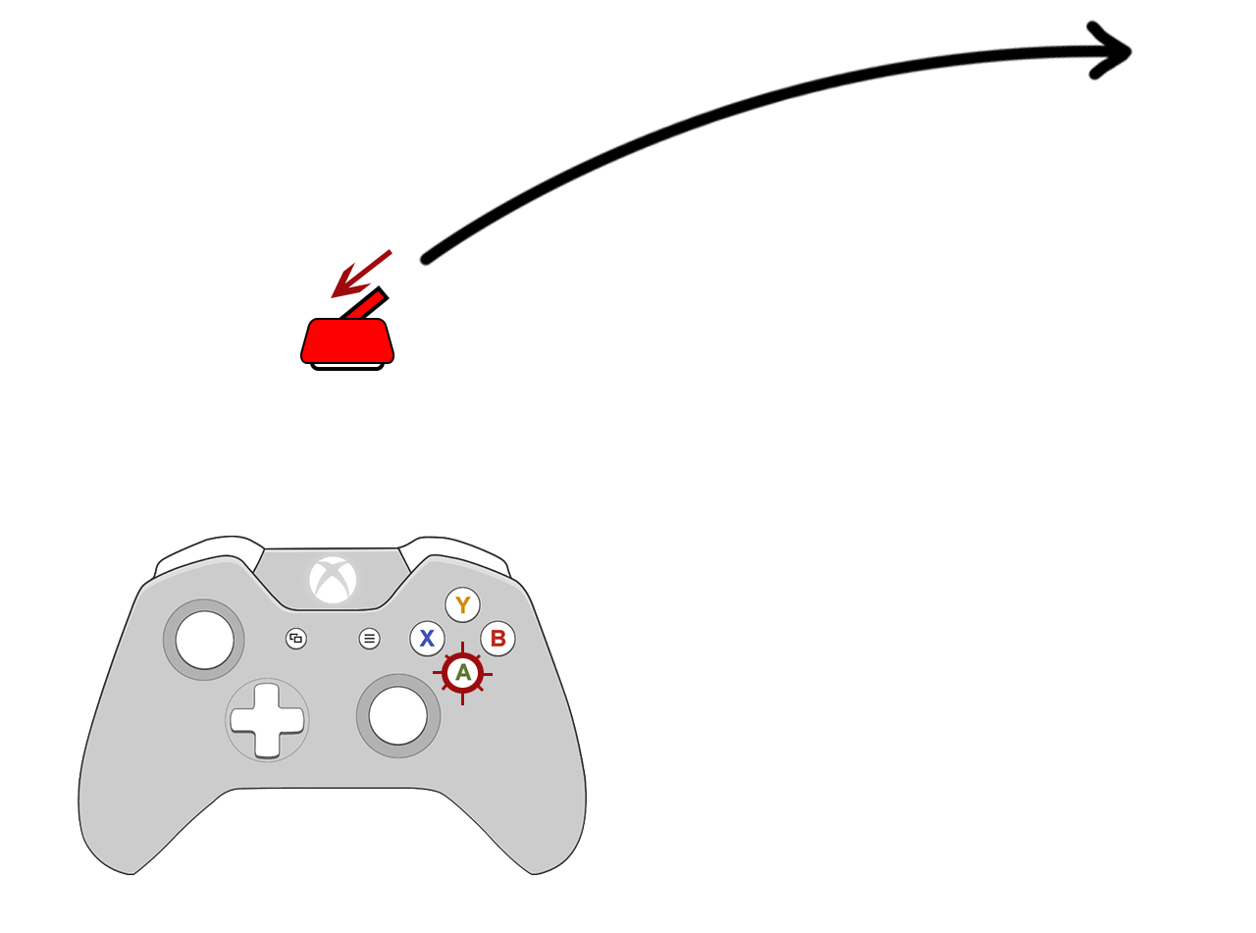
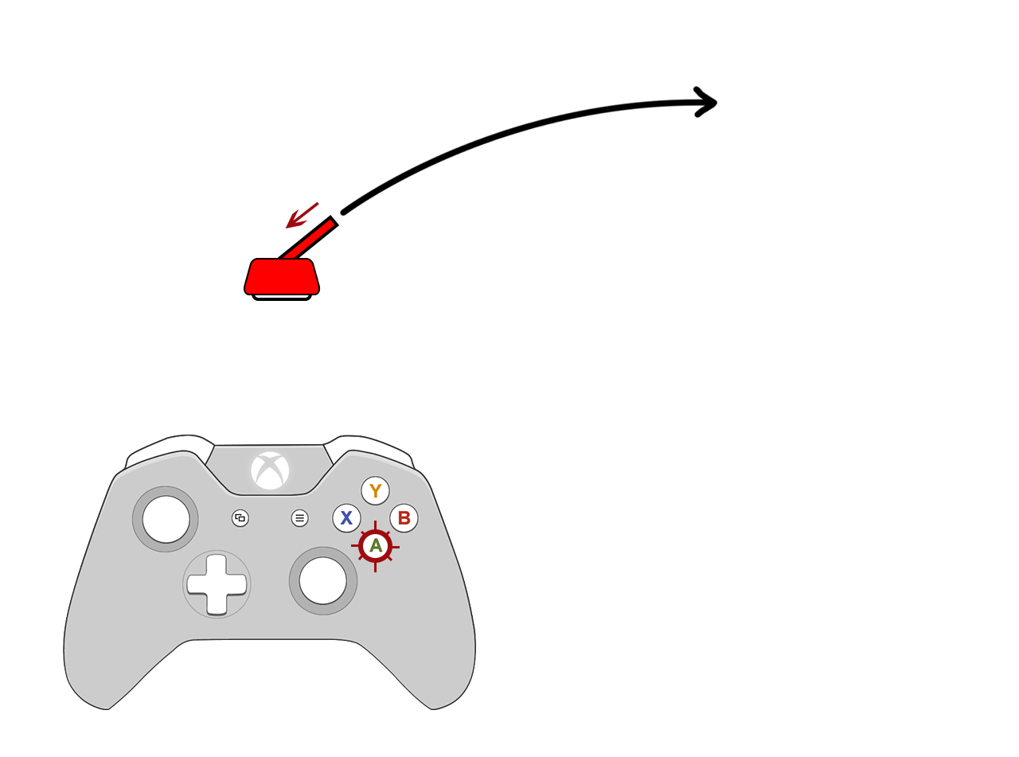
Main Mechanic
Recoil

Slide 8
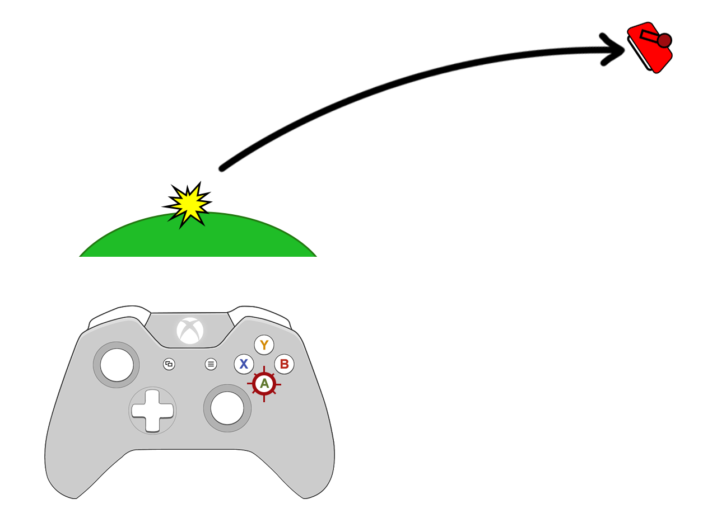
Main Mechanic
Recoil

Slide 9
Level Design / Art Style
2D top down
Sliding screen arena

Slide 10

Level Theme/Layout
Concept Characters

Slide 11
First Iteration of Game

Slide 12
Final Delivery
Refined Menu & Tutorial Screen.
Refined Recoil & Knockback to feel natural.
Add an Additional 2 players & play test 4 player arena.

Slide 13
Meeting the Brief
Physics driven by Knockback & Recoil.
The arena uses symmetry to enable balance between the players.
The game’s originality comes from the theme; as well as knockback physics.

Slide 14
Any Questions?

